Slide 1
Introduction to Zoom Session 5 (Present 2 of 2)
Ellen Voorhees
https://github.com/kwchurch/Benchmarking_past_present_future - S5

Slide 2
Zoom Session 4: Future https://github.com/kwchurch/Benchmarking_past_present_future#S4
Moderator: Ellen Voorhees
Nan Duan, Qi Zhang and Ming Zhou
Hua Wu and Jing Liu
Neville Ryant

Slide 3
An Industry Perspective Hua Wu and Jing Liu (Baidu)
Outlines some of the ways benchmark tasks are not representative of tasks that industry cares about.
It also describes a suite of benchmarks Baidu is creating to address these shortcomings and an open-source project called LUGE focused on building NLP benchmarks for Chinese NLP.

Slide 4
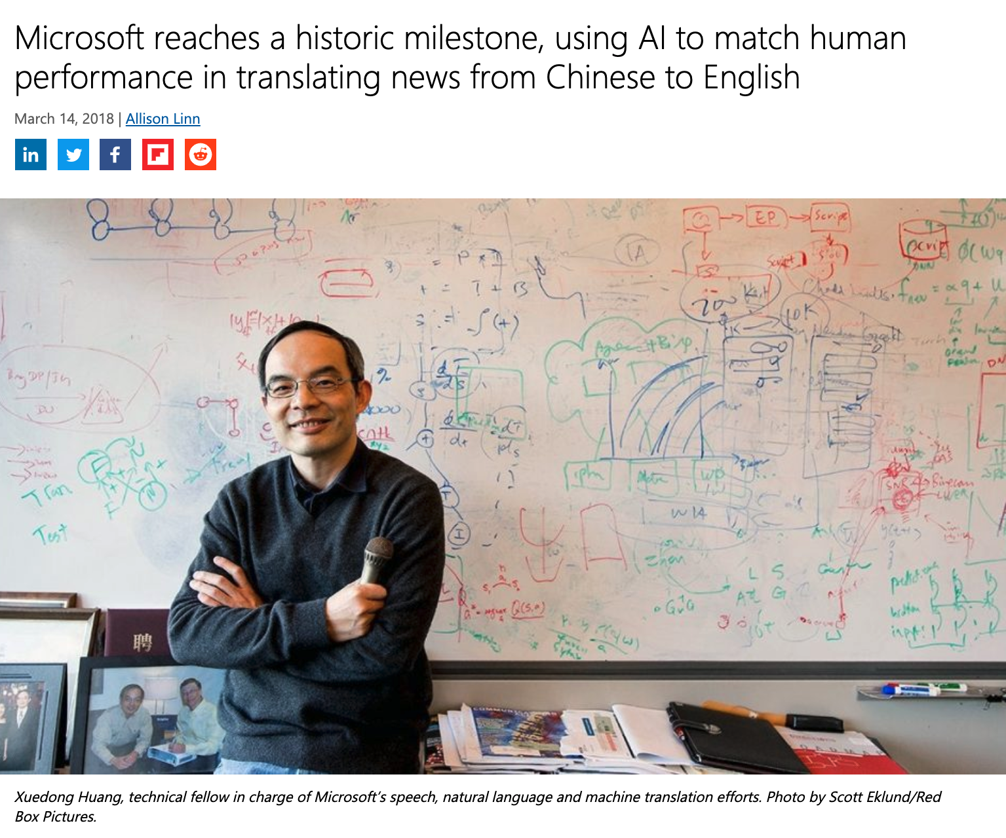
Really Reaching Human Parity? Addressing Benchmark Issues on Robustness, Bias and Metrics Nan Duan, Qi Zhang and Ming Zhou
Like the previous talk,
this talk also describes a benchmarking suite (XGLUE)
being developed at MSR Asia
designed to be a comprehensive multi-lingual test set for NLP.
https://blogs.microsoft.com/ai/chinese-to-english-translator-milestone/

Slide 5
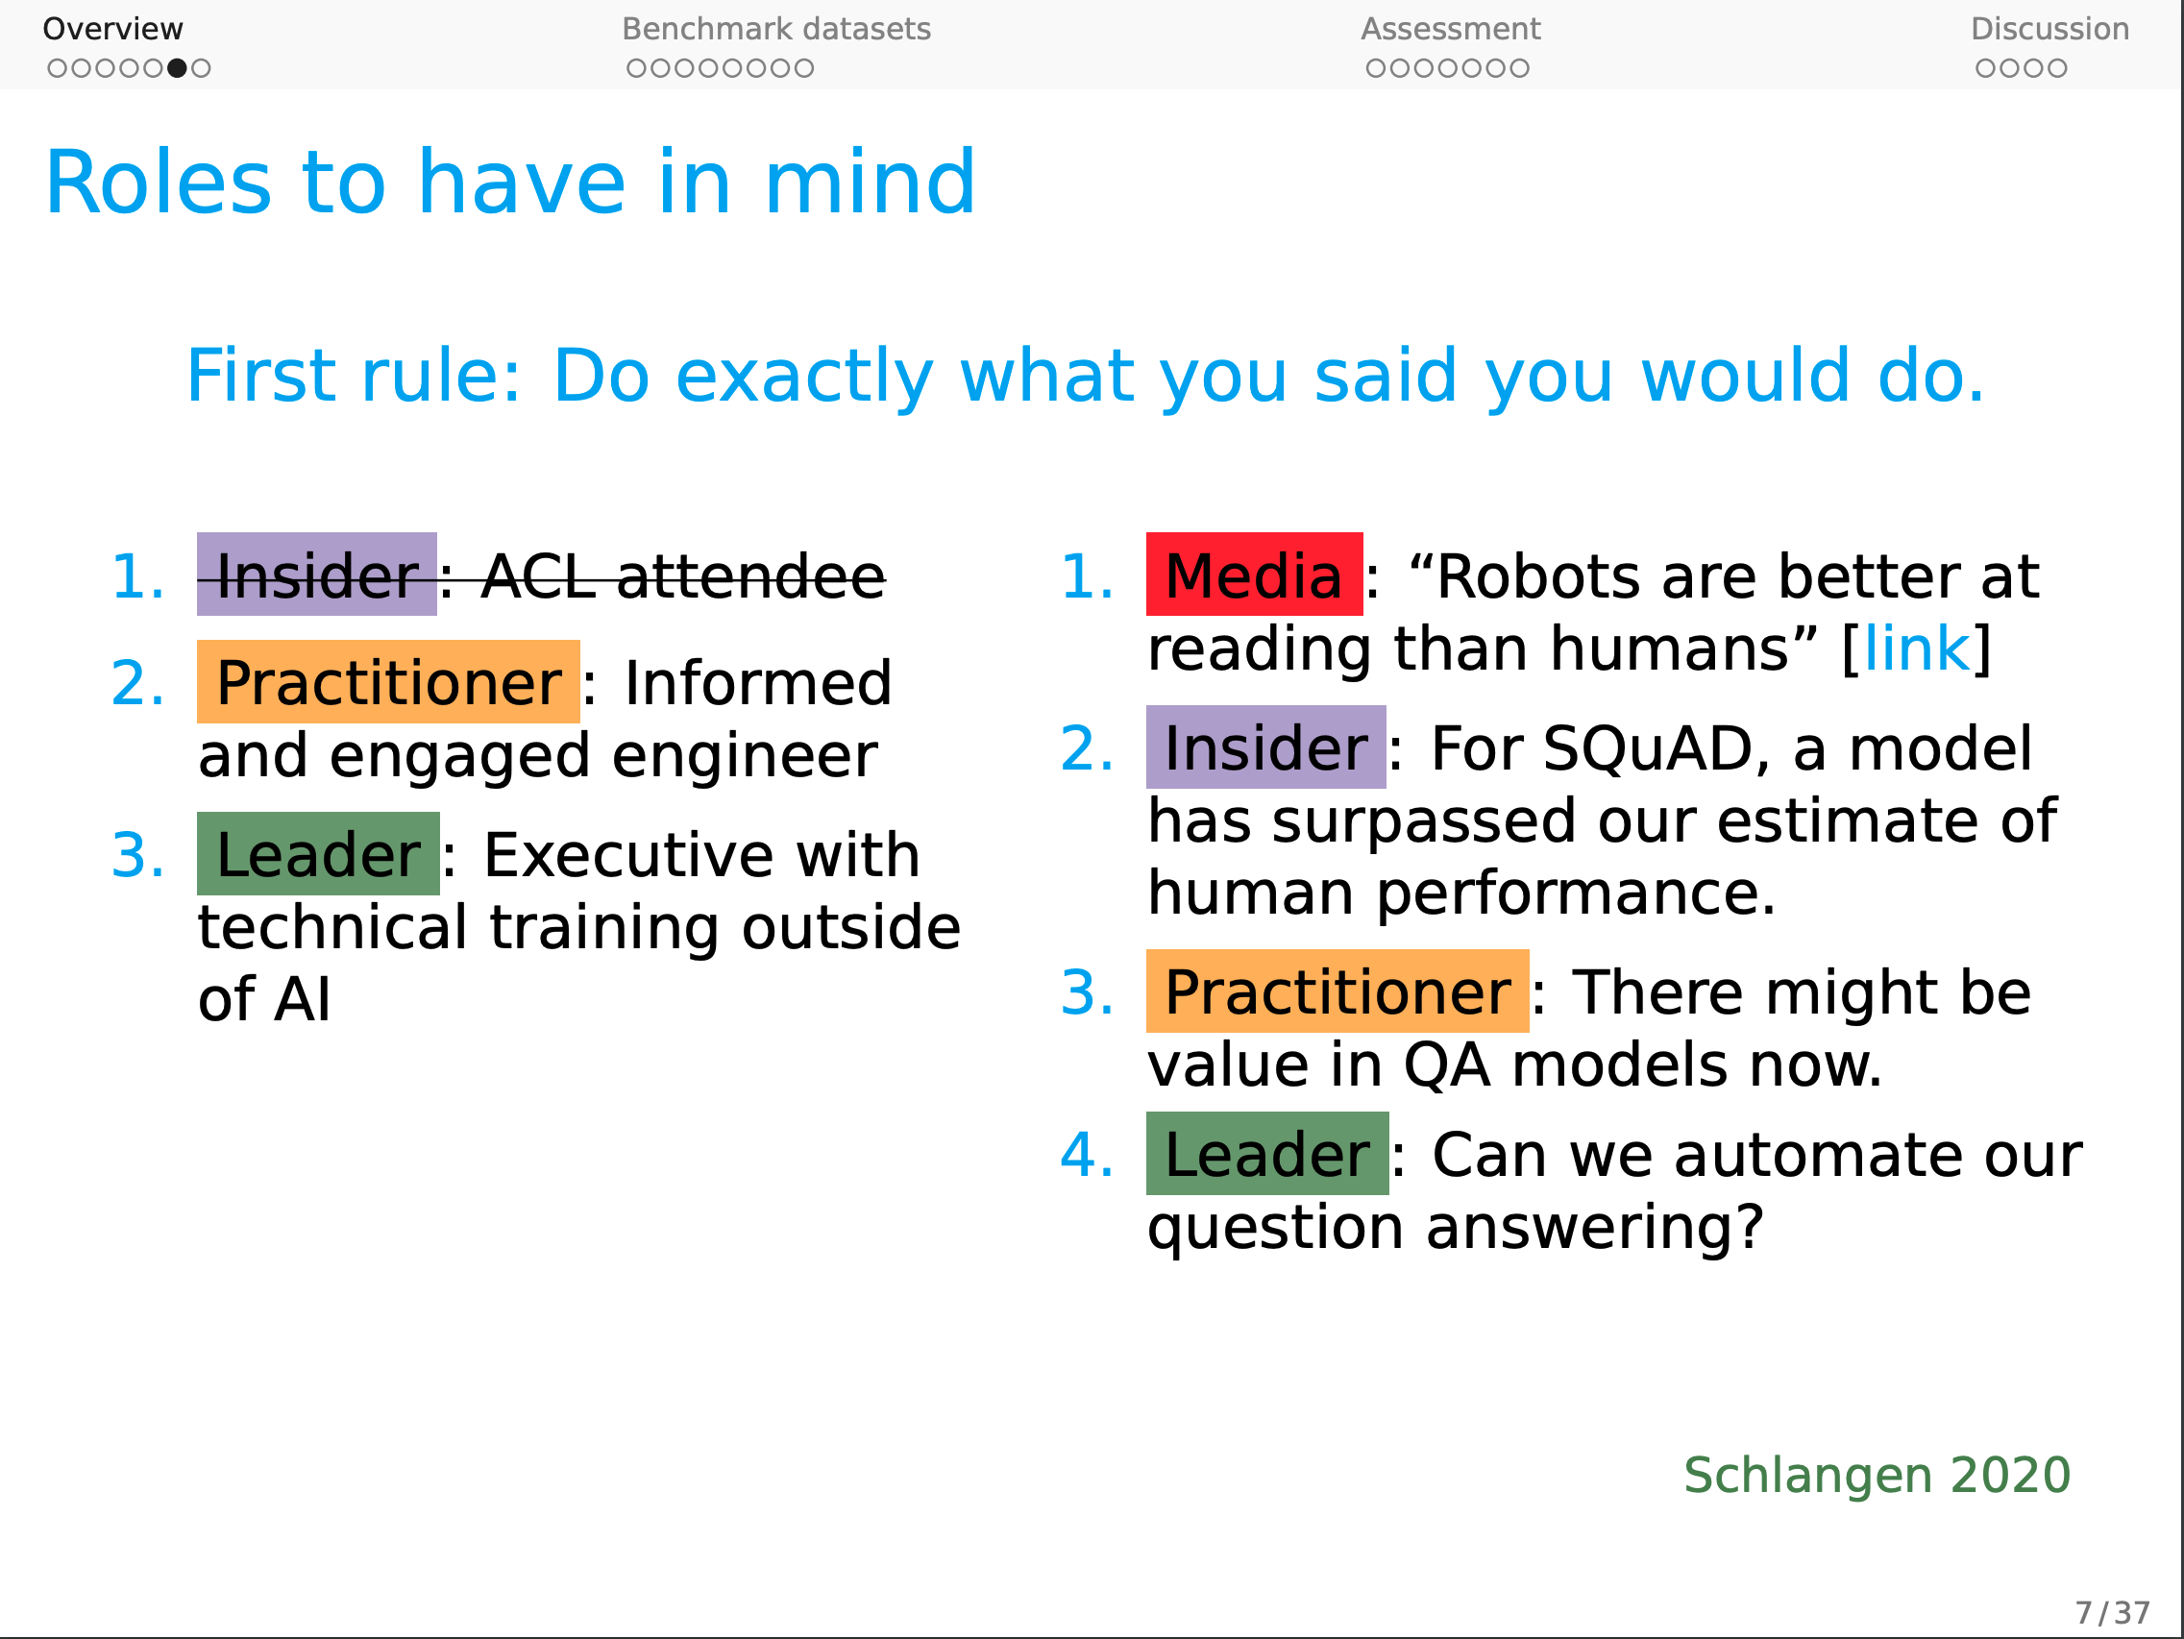
https://web.stanford.edu/~cgpotts/talks/potts-acl2021-slides-handout.pdf

Slide 6
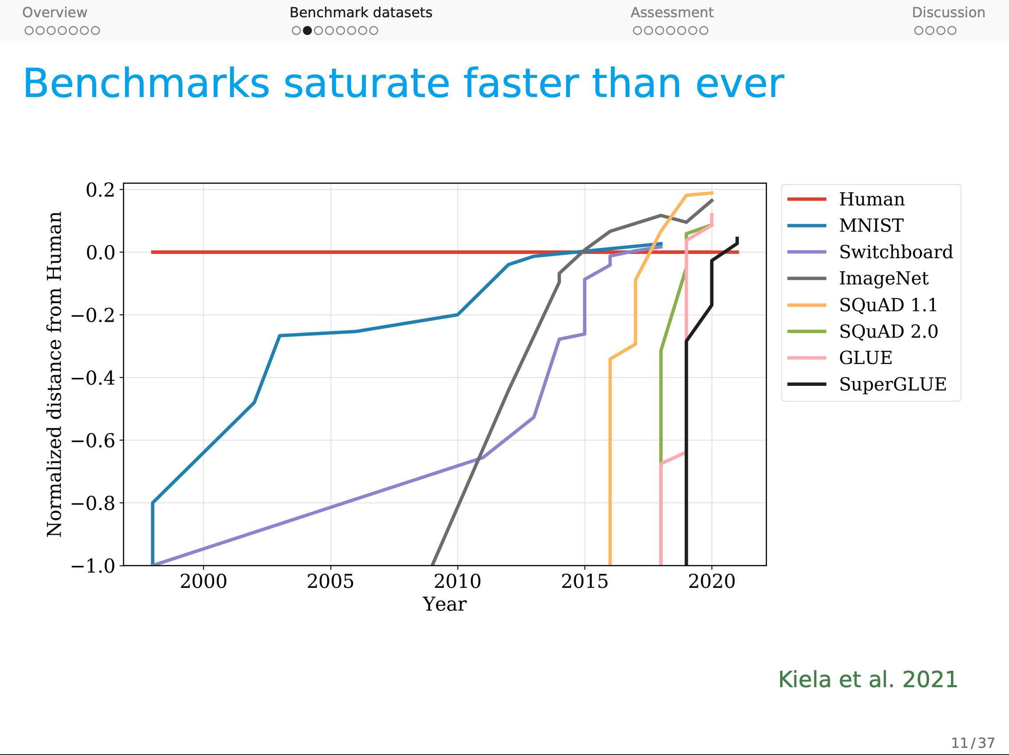
https://web.stanford.edu/~cgpotts/talks/potts-acl2021-slides-handout.pdf

Slide 7
Benchmarking for diarization:
Lessons from the DIHARD evaluation series
Neville Ryant
Linguistic Data Consortium
nryant@ldc.upenn.edu

Slide 8
DIHARD is Hard Neville Ryant
Diarization: Who spoke when
Input: Audio
Output: Turns = intervals + colors
Terry Gross: Did you get any royalties since you'd already sold the song?
Willie Nelson: Not really. {laughs} Not really.
Terry Gross: Would you- would you sing us a bit of the "Family Bible” and tell us what went into the writing of it?
Willie Nelson: Well, this is sort of autobiographical, or practically 100 percent autobiographical.
What were we thinking?
Literature was too rosy
Diarization was declared ``solved’’
Promised to ship a solution
Ran out of time
We shipped what we had, but…
Plan B: Seek help from community
Purpose of JSALT workshop
Reality check / reset expectations
Convince everyone: not ``solved’’
Ryant talks about beating folks up…
Encourage more work
IBM could not afford to do
what needed to be done
to make our product
meet customer expectations

Slide 9
Why did we think it would be easy?

Slide 10
Purpose of Benchmarking → Realistic Expectations
Spring
Winter

